Slide 1

Project Work
Portfolio
XInwei Chen

Slide 2


Contact Card
Notes:
The creative product here is the contact card in dark version, which can be used in the event to distribute latest information

Slide 3


Contact Card
Notes:
The creative product here is the contact card in light version, which can be used in the event to distribute latest information

Slide 4
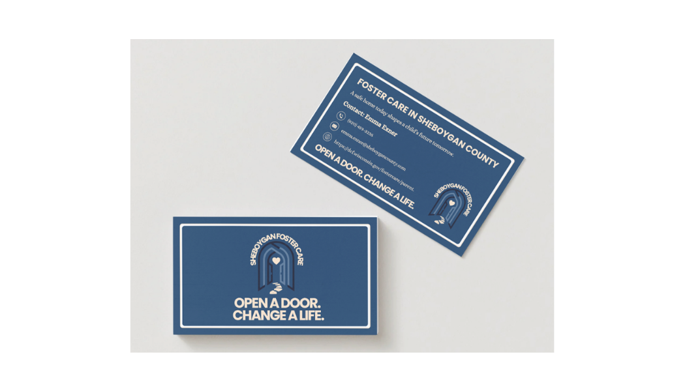
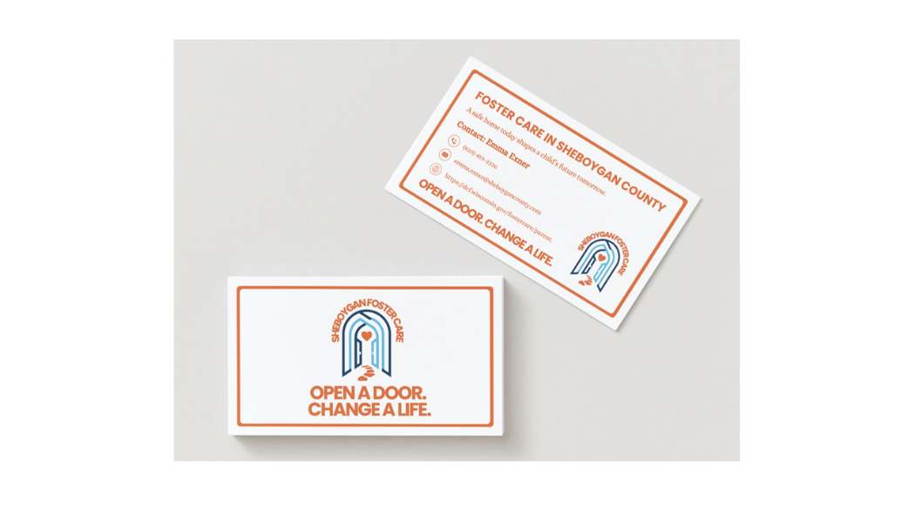
Contact Card
Notes:
These are the mock-ups for the two versions of contact cards. This helps how contact cards look like in real life.

Slide 5
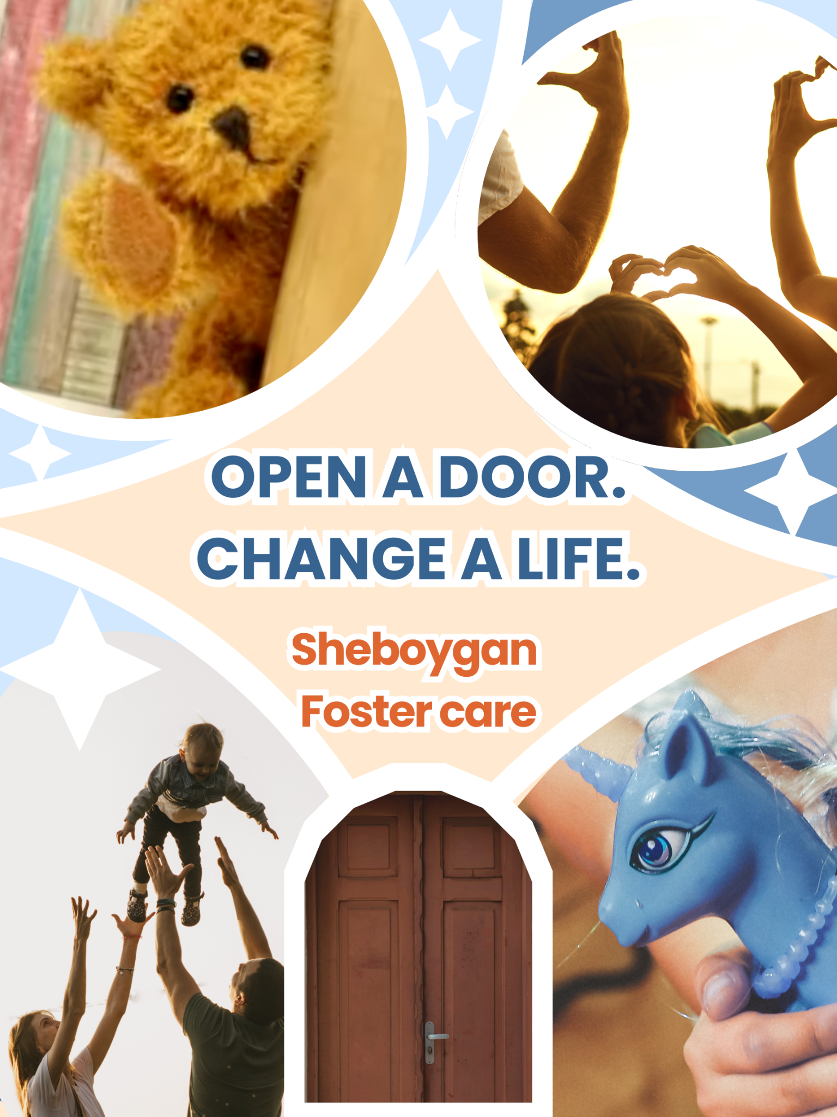


Print Ads
Notes:
This page features my contribution to our creative print ads. The left piece was created in the initial stages and aims to show how foster care builds connections between children and families. The middle piece takes a more professional approach, centering on meaningful moments shared between foster parents and children. The message, “Your welcome becomes the key to their future,” directly addresses viewers and functions as a clear call to action. The right piece uses spherical and cubic shapes, placing the child on a platform and looking toward those who were fortunate enough to find a foster family. This print ad is designed to elicit empathy from viewers, while the inclusion of statistics adds strength and persuasive power to the overall creative message.

Slide 6
Situation Analysis
Introduction
In the mid-20th century, the U.S. government promoted foster care as an alternative to orphanages to care for children in need. In 1971, the Wisconsin Foster Parent Association (wfapa.org) supported foster care at the state level. Today, foster care plays an essential role in caring for children in need of a stable home environment. In Wisconsin, foster care is administered at the county level.
In Sheboygan County, its Health and Human Services department administers the Sheboygan County Foster Care (SCFC) program, which recruits and supervises foster care and offers accessible resources for existing and potential poster parents. Most children placed in Sheboygan country are those who have been removed from their parents or primary caregivers. In order to find safe places for the children to live, Sheboygan Human Services staff connect potential foster families with children in need. Though the primary goal is ultimately reunification, foster care may result in guardianship or adoption by relatives or foster families.
Foster parents are licensed and trained to make sure the children stay connected to their communities. According to the Wisconsin Department of Children and Family, the licensed foster parents receive a foster care payment to reimburse for the care of a foster child, called the Uniform Foster Care Rate. Besides the support from the government, there are non-profit organizations such as Kindred Heart Families, Inc., that provide essentials to children in foster care and reduce the financial burden of providing foster care.
Notes:
In the research stage, I took charge of the background analysis and possible target audiences profile.

Slide 7
Situation Analysis
SWOT Analysis
Strengths
Strong local reputation and high community trust.
Deep emotional connection with families and a clear mission focused on reunification.
Consistent visibility at community events and positive engagement when content becomes personal
Sheboygan County Foster Care has a strong foundation for authentic outreach. Its personable staff and emotional resonance with families are powerful differentiators that larger competitors may not match. Community presence also builds familiarity and trust
Weaknesses
Rely on Facebook with limited presence across other digital platforms.
Low brand visibility, with minimal organic conversation about fostering.
Informational tone that limits engagement.
Public misunderstanding of foster care and limited networks.
Recruitment and retention challenges driven by regulatory burdens and barriers to entry
Most weaknesses stem from a narrow communication strategy and outdated digital infrastructure. Limited storytelling and unclear value proposition reduce the likelihood that potential foster parents.
Notes:
After we got the first situation analysis, I condensed the messages and make it more clear to present. Due to the limited space here, the slide contains firstly for strengths and weaknesses.

Slide 8
Situation Analysis
SWOT Analysis
Opportunities
Build credibility through empathetic digital storytelling and real community stories.
Expand presence to other digital platforms to reach younger and more diverse audiences.
Strengthen partnerships with churches, schools, and neighborhood organizations to deepen local ties.
Improve website UX and streamline the application process.
Highlight a unique selling proposition such as keeping children in their home neighborhood.
There is a major opportunity to modernize Sheboygan Foster Care’s digital identity. A strategy of storytelling, and educational messaging can help address misconceptions and differentiate SCFC from larger statewide competitors.
Threats
Stronger competition from more established rivals with larger budgets.
Persistent negative public perceptions of foster care.
Funding instability limits sustained marketing efforts.
Competing volunteer opportunities that require lower commitment.
External threats mostly relate to public skepticism toward the foster system and competition for attention. Without proactive recruitment and better digital communication, potential foster parents may choose alternative volunteer paths or opt out of fostering entirely.
Notes:
After we got the first situation analysis, I condensed the messages and make it more clear to present. This slide showcases threats and opportunities.

Slide 9
Creative Message
Possible Theme
Home Grown Hope
Fostering Connection
Possible creative media for final theme:
Big moments like graduation ceremonies, birthdays, college acceptance, etc.
Notes:
Apart from our final theme and slogan, I worked with my team members to come up with possible themes and creative ideas.

